Slide 1

What would you do?

Slide 2




Notes:
This slide can be used if you want to discuss how we know we are on the internet / how do we access the internet.

Slide 3


Slide 4

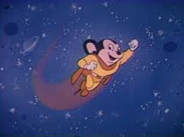


Mighty Mouse
Stuck on a tricky level?
Click for a cheat
Pay once: unlimited use
Notes:
Is this a genuine part of a game you are playing? What is the cost? Is it sensible to pay that much?

Slide 5

Confirm Your In App Purchase
Cancel
Buy
Notes:
How much are you spending? – if not sure you should cancel. Do you need to check with an adult?

Slide 6

Congratulations!
We are offering you a chance to win £500 of vouchers to spend in ASDA
Simply complete our 20 second survey
Question 1 of 5
Are you male or female?
Male Female
Notes:
If it sounds too good to be true …

Slide 7
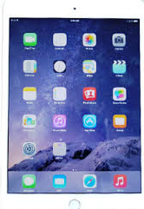
Register your email address
To win an iPad
No purchase necessary
One winner will be drawn each week
Must be over 18 to be eligible
Register here
Notes:
If it sounds too good to be true …

Slide 8





X
BUY
With Gold
You have 10,342 Gold Bars
BUY
With Stars
Cool Hair!
This hair will make you look amazing
You have 3,870 Stars
Notes:
There is unlikely to be a problem with this one as long as it is in the context of the game the person is playing. This assumes that the player has earned gold bars and stars as part of the game. As long as no money is requested once the person clicks on buy with gold/stars, the user can go ahead. However, if it is not a part of a game it could be a trick to download a virus to your device.

Slide 9

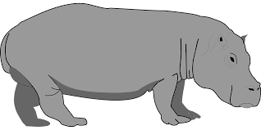
Dibs!
A rare, cool item can be yours for free!
Someone else is trying to snatch it. Call dibs on it and make it yours!
Proceed
Notes:
Beware, you are being encouraged to act quickly. If it sounds too good to be true …
Could be virus, could be a company that will be asking for personal details. As it could be a virus, do not click on proceed.

Slide 10



Don’t let a virus harm your device!

Slide 11
What pop up would you design?

